Slide 1
If at first you don’t succeed, try again

Slide 2
Our Proposal
Our Proposal originally was based on Zomato and Just-eats.\
Our idea was to track the areas in Toronto with the most orders, most popular rating, and the most “hot” and active regions during certain days of the week.
Unfortunately, we were unable to query sufficient amounts of data (we were only able to query 5 records at a time)
Due to limited data, we were unable to attain sufficient amounts of data in order to conduct some semi-ok analysis.
Therefore, we had to think of something quick before we lost another day.

Slide 3
Proposal 2.0
Due to the data shortage from our last proposal, we considered a better source of data that is free and abundant in relevant information for the typical person living in Canada.
The labour market came to mind, and the search for data was established and StatsCan, thankfully, was able to provide an abundant wealth of data on the Canadian Labour market’s characteristics.
As a result of gathering much data, we were very hopeful and naïve as too how hard this project was about to become and to how much data we were actually able to handle as a 3 person group.

Slide 4

Canadian Labour Market at Glance
Carlos Denise Ian

Slide 5
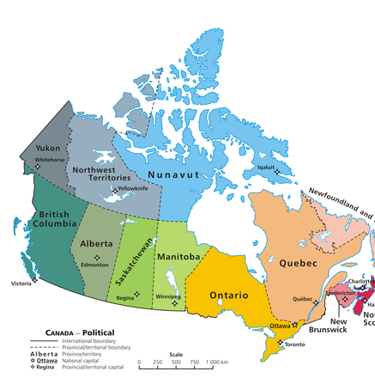
Our Motivation
To provide users the ability to gain quick at a glance insight of the condition of the Canadian Labour Market previously and currently.
Our goal to our motivation is to preform individual agents with the most up-to-date information y make informed and rationalized decisions based on the conditions and trends of the Canadian Economic and Social atmosphere.

Slide 6
Gathering our Information
Our first step to our project was gathering the information.
As a group, we collectively searched for data that was relevant enough in our judgement to display to any user to provide some type of insight into the Canadian labour market in the past and current.
We even searched for Monetary and Fiscal indicators to tie into our labour market characteristics to figure out some pattern and interesting insights into data when you put them against each other on a scatter plot. As a result, we were able to conduct a test of an attempt to replicate the Phillips Curve and predict future values of CPI in the next 10 years.

Slide 7

Our Variables
The Variables we retrieved, after much error and trial of keeping and dropping data sets, ended up with the following variables.
Population data (Male, Female, Both)
Gini-Index (Provincial, Country)
Consumer Price Index (Provincial, Country)
Labour Force Characteristics (employment, unemployment, Provincial and Country)
Wages (Difference between industries in Canada)
Tax Revenue (Provincial, Country)

Slide 8
The Labour Market
What is the Labour Market?
A labour market is the place where workers and employees interact with each other. In the labour market, employers compete to hire the best, and the workers compete for the best satisfying job. ... In this market, labour demand is the firm's demand for labour and supply is the worker's supply of labour.
Labour Market Theories and Education decline as more people are employed. The marginal productivity theory thus provides an explanation of labour demand. It suggests that the number of workers a firm will employ and the wage they will be paid depends, among other things, on the productivity of those workers.

Slide 9
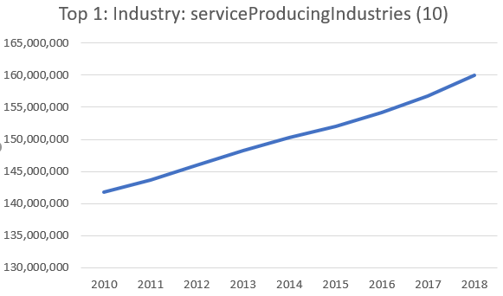
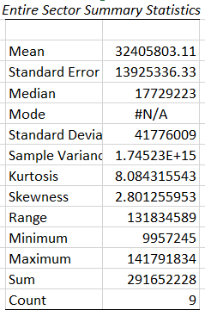
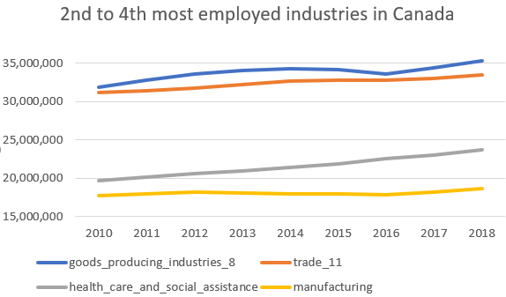
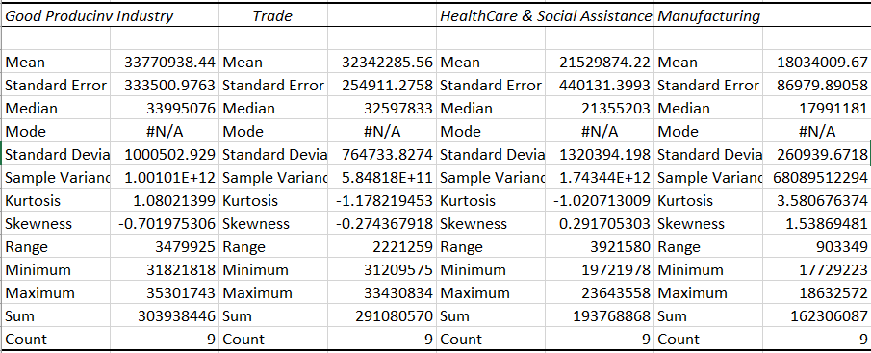
Graphs on the top 5 industries of Labour Market

Slide 10
The Philips Curve
What is the Phillips Curve?
The Phillips curve is an economic concept developed by A. W. Phillips stating that inflation and unemployment have a stable and inverse relationship. The theory claims that with economic growth comes inflation, which in turn should lead to more jobs and less unemployment.
How does it work?
As inflation accelerates, workers may supply labor in the short term because of higher wages – leading to a decline in the unemployment rate. Therefore, over the long-term, higher inflation would not benefit the economy through a lower rate of unemployment.

Slide 11
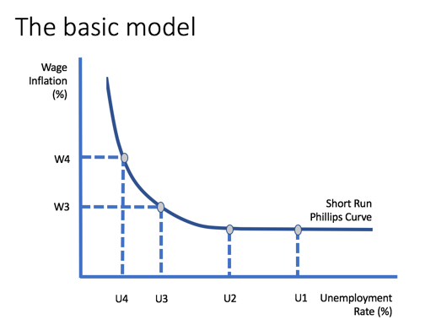
The model of Phillips Curve v.s the replicated Phillips curve.

Slide 12
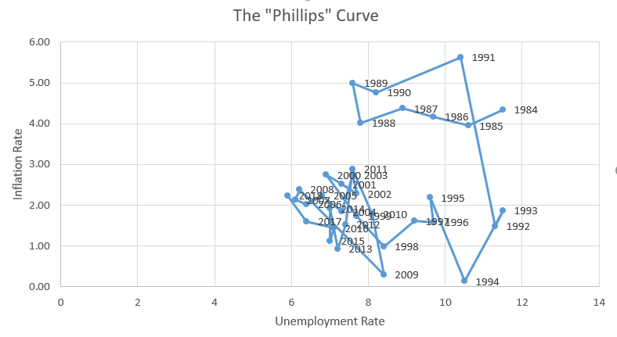
The model of Phillips Curve v.s the replicated Phillips curve.

Slide 13
Our insights from our replicated Phillips Curve
Our replication does not match the basic model of the Phillips curve.
In fact, according to the Phillips curve, as the inflation rate drops, unemployment rate may rise, and vice versa, but in our model, we have instances where inflation from 1989 to 1991, inflation raises over time, yet unemployment rises as well (YIKES, might be time to buy those Apple stocks to smooth your consumption for future periods)
Another interesting insight we attain is that, even when inflation decreases, the unemployment rate also decreases (Great, the rise in price is slowing and the population is becoming more active in the labour force.

Slide 14
So what’s the deal with the Phillips Curve?
“The puzzle and promise of the Phillips curve is the idea that tighter labor markets, traditionally measured by the unemployment rate, correlate with higher wages and prices. That takes more doing. Typically, you have to think that workers are fooled into working for what they think are higher real wages, and only later discover that prices have gone up too. And you have to think that firms rather mechanically raise prices passing on higher labor costs, and keep selling things when they do. Despite the intuitive appeal of tight markets leading to rising prices and wages, that simple intuition is wrong to describe a correlation between tight markets and both prices and wages, which is what the Phillips curve is an
Most economists no longer use the Phillips curve in its original form because it was shown to be too simplistic.^{[16]} This can be seen in a cursory analysis of US inflation and unemployment data from 1953–92. There is no single curve that will fit the data, but there are three rough aggregations—1955–71, 1974–84, and 1985–92—each of which shows a general, downwards slope, but at three very different levels with the shifts occurring abruptly. The data for 1953–54 and 1972–73 do not group easily, and a more formal analysis posits up to five groups/curves over the period.^{[5]}d was.”

Slide 15
Time Series Forecasting
What is Time Series Forecasting?
“Time series forecasting is a technique for the prediction of events through a sequence of time. The technique is used across many fields of study, from the geology to behavior to economics. The techniques predict future events by analyzing the trends of the past, on the assumption that future trends will hold similar to historical trends.”
Time series forecasting is performed in a variety of applications including:
Weather forecasting
Earthquake prediction
Astronomy
Statistics
Mathematical finance
Econometrics
Pattern recognition
Signal processing
Control engineering

Slide 16
Techniques of Time Series Forecasting
Method 1: The Moving Average (MA model) Moving averages can be used to quickly identify whether selling is moving in an uptrend or a downtrend depending on the pattern captured by the moving average.
Method 2: Exponential Smoothing: Exponential smoothing is usually a way of “smoothing” out the data by removing much of the “noise” (random effect) from the data by giving a better forecast.
Method 3: Autoregressive Integrated Moving Average (ARIMA)
Method 4: Neural Network
Neural networks, has its own strength to derive meaning from complicated or imprecise data, and most of the time can be used to detect the pattern and trend in the data, which cannot be detectable easily from human eye or any computer techniques. We also have some of the advantage of NN like Adaptive learning, self-organization, real-time operation, fault tolerance.

Slide 17
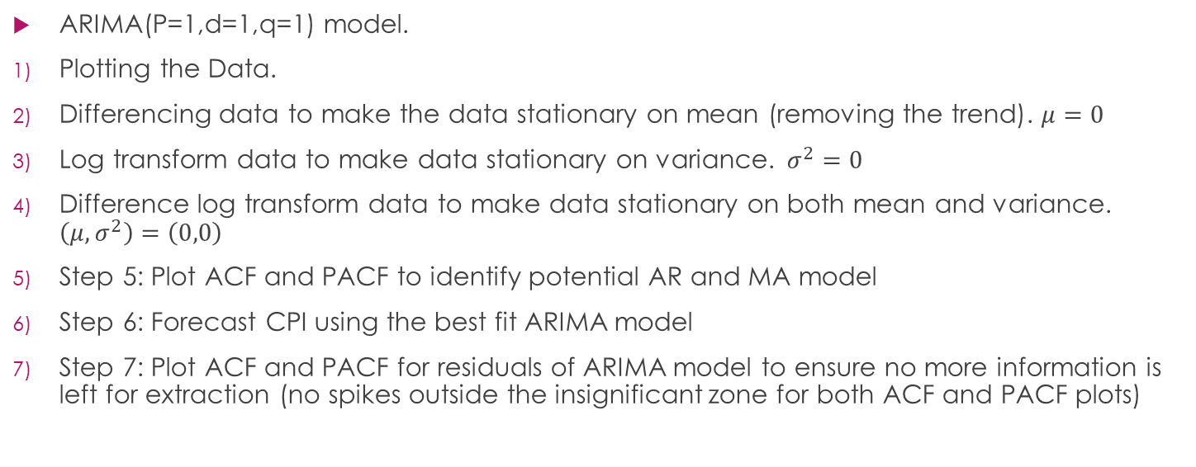
The technique we used for CPI Forecasting
ARIMA(P=1,d=1,q=1) model.
Plotting the Data.
Differencing data to make the data stationary on mean (removing the trend). $μ=0$
Log transform data to make data stationary on variance. $σ^{2}=0$
Difference log transform data to make data stationary on both mean and variance. $\left(μ,σ^{2}\right)=\left(0,0\right)$
Step 5: Plot ACF and PACF to identify potential AR and MA model
Step 6: Forecast CPI using the best fit ARIMA model
Step 7: Plot ACF and PACF for residuals of ARIMA model to ensure no more information is left for extraction (no spikes outside the insignificant zone for both ACF and PACF plots)

Slide 18
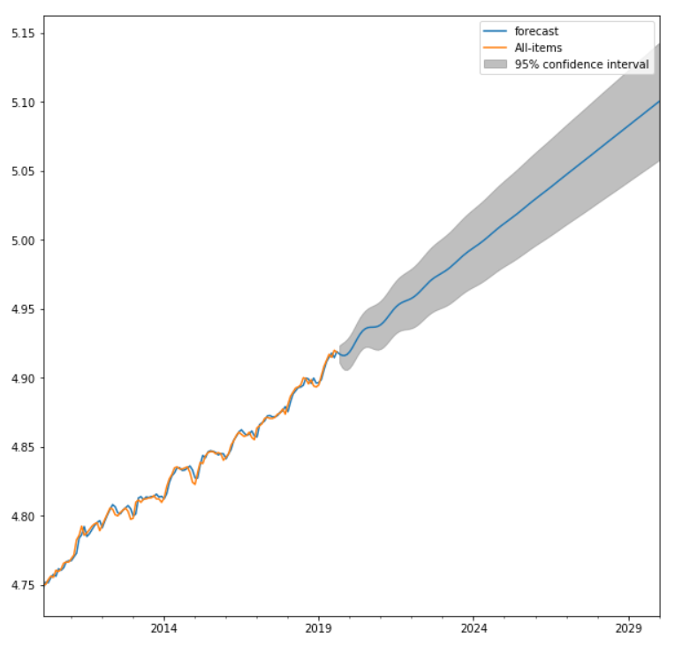
Times Series Forecast CPI

